Slide 1
Testing

Slide 2
Why test?
To decrease the amount of bugs

Slide 3
How
Execute the program with different sets of inputs and outputs and validate the results

Slide 4
Shortcoming
Shows the presence, not the absence of defects.

Slide 5
Testing
White box
Black box
public bool IsGreater(int x, int y)
{
if (x is null || y is null)
throw new Exception();
if (x > y)
{
return true;
}
else
{
return false;
}
}
IsGreater(-1, 0);
IsGreater(10, 5);
IsGreater(5, 10);

Slide 6
White box testing: coverage
Flow independent
Flow dependent
Block
Line
Statement
Branch
Path

Slide 7
public bool IsGreater(int x, int y)
{
if (x is null || y is null)
throw new Exception();
if (x > y)
{
return true;
}
else
{
return false;
}
}

Slide 8
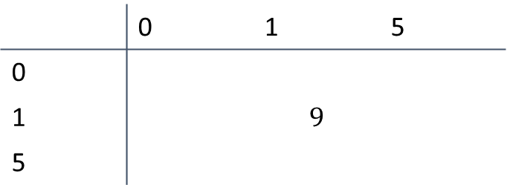
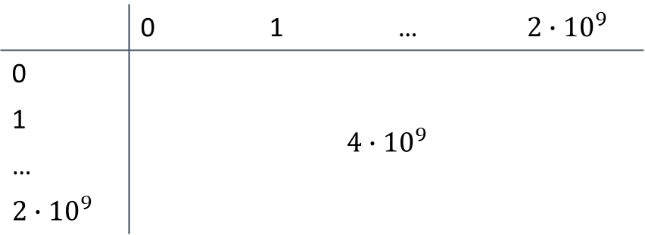
Equivalence class partitioning
 | 0 | 1 | … | $$2∙{10}^{9}$$
0 | $$4∙{10}^{9}$$
1
…
$$2∙{10}^{9}$$
 | 0 | 1 | 5
0 | $$9$$
1
5

Slide 9
Boundary value analysis

Slide 10
Quiz
Why do we need testing?
What is the defect of testing?
What is the difference between the white box and the black box testing?

